Slide 1
Maps, Movies and Multi-Player Games: Collaborative Environment to Make Programming More Engaging https://netsblox.org
CSTA Conference 2018
Workshop
Akos Ledeczi and Brian Broll
akos.ledeczi@vanderbilt.edu
Peter Volgyesi, Janos Sallai, Hamid Zare, Miklos Maroti

Slide 2
NetsBlox
The IDEA:
Add distributed programming capabilities to Snap!
Why?
The majority of computer applications we interact with are distributed/networked, so why not learn the basics?
Increased motivation for high schools students
Combine CS with other STEM disciplines
Enhance collaboration
Cool ☺
What does it enable?
Multi-player games and other distributed programs like chat
Access to the wealth of STEAM data on the Internet
Collaboration: pair programming, group projects, etc.
Collaborative robotics and hands-on cyber security education

Slide 3
Workshop Agenda
Introduction to distributed programming with NetsBlox.
Creating NetsBlox accounts and logging in.
Building an interactive Weather app.
Break (10 min)
Demonstration of other apps using online data (Charts, Movies, etc.).
Building a Chat room for the entire class.
Break (10 min)
Demonstration of additional distributed apps like shared whiteboard and multi-player games.
Demonstration of robotics and cyber security with NetsBlox
Q&A

Slide 4
Collaboration
Code editing a la Google Docs
Pair programming
Group projects
What is synchronized?
Everything that does not change by running the program
Sprites and scripts
What is not synchronized?
Everything that change by running the program
The state of the stage and sprites (location, orientation, etc.)
Variable values
Users can work together on the program but each executes it on his/her computer independently

Slide 5
Distributed Programming Primitives
Simple abstractions:
hide accidental complexities, but expose the fundamental concepts
Abstractions:
Remote Procedure Calls (RPC)
Message Passing
Room:
Comprised of multiple Roles (subprojects running on a separate computers)

Slide 6
Remote Procedure Calls
RPC: call functions on the server
Multiple input arguments
One output argument
Blocking call
Grouped into services that wrap various web APIs
Google Maps, weather, earthquake, museums, movies etc.
Game management
Tic Tac Toe, Battleship, Hangman, etc.

Slide 7
Let’s Get to Work!

Slide 8
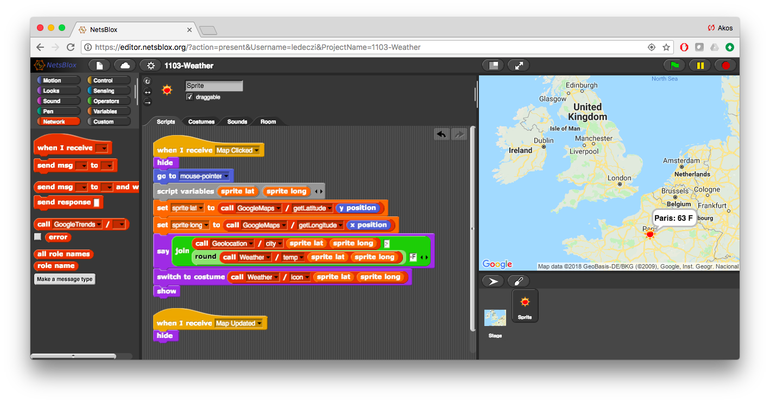
Interactive Weather App
Stage: Google maps background with zooming and panning
Sprite: Jumps to wherever the user clicks and displays current conditions with a weather icon and shows the name of the closest city and current temperature

Slide 9
BREAK

Slide 10
Additional Projects
Street view
Movie cast pictures
Charting
Earthquake

Slide 11
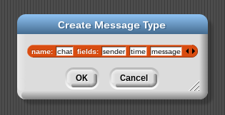
Message Passing
Similar to Events in Snap!
Carry data
Can go from one computer to another
Messages in NetsBlox:
Message type editor:

Slide 12
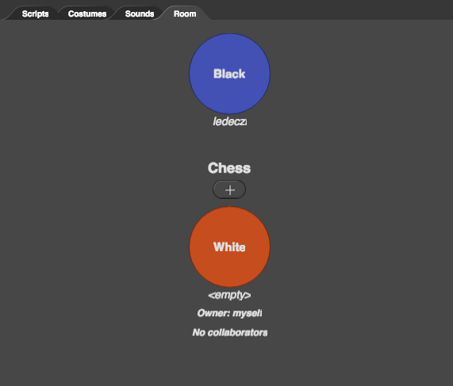
The Room
Set of roles/clients participating in the distributed application
Each role has its own set of sprites, stage and scripts
The owner invites other users to participate by “playing” a given role
Messages can be sent to these users (i.e., roles)
A new instance of the room is created for every new run of the application

Slide 13
Addressing
Local:
Within the same Room using simply the role name
Similar to calling the extension within your organization (no need for the entire phone number, area code, country code)
Global:
How to send a message to any NetsBlox application?
Need globally unique address:
rolename@projectname@username
Called “public role ID”
Similar to phone calls: country code, area code, number
Helper RPC returns your own public role ID:

Slide 14
Simple Texting App
Two different NetsBlox programs:
Server:
Running on my laptop and shown on the projector
Accepts and displays messages received
Client:
Running on your laptop
Sends text messages to the server
Server
Clients

Slide 15
Let’s Get to Work!

Slide 16
Chat Room
Server:
Running on my laptop and shown on the projector
Accepts and registers clients
Accepts and displays messages and sends them to all registered clients
Client:
Running on your laptop
Sends text messages to the server
Accepts and displays text messages from the server
Need to agree on a Communication Protocol:
Message types
Order of messages
Chat room protocol:
Client sends its own address (public role id) to the server: connect message
Client sends text message to the server
Server broadcasts received text message to every registered client

Slide 17
Chat Room Message Types
Connect message
Name: connect
Field: address
Chat message
Name: chat
Fields: sender txt
Names have to match perfectly!!!
Capitalization matters!!!
connect message contains the client’s public role id, so that the server can send messages to the client
chat message sender field should be simply your name

Slide 18
Let’s Get to Work!

Slide 19
BREAK

Slide 20
Multi-Player Games
Dice
Turn-based game: 21 pebbles
Shared whiteboard

Slide 21
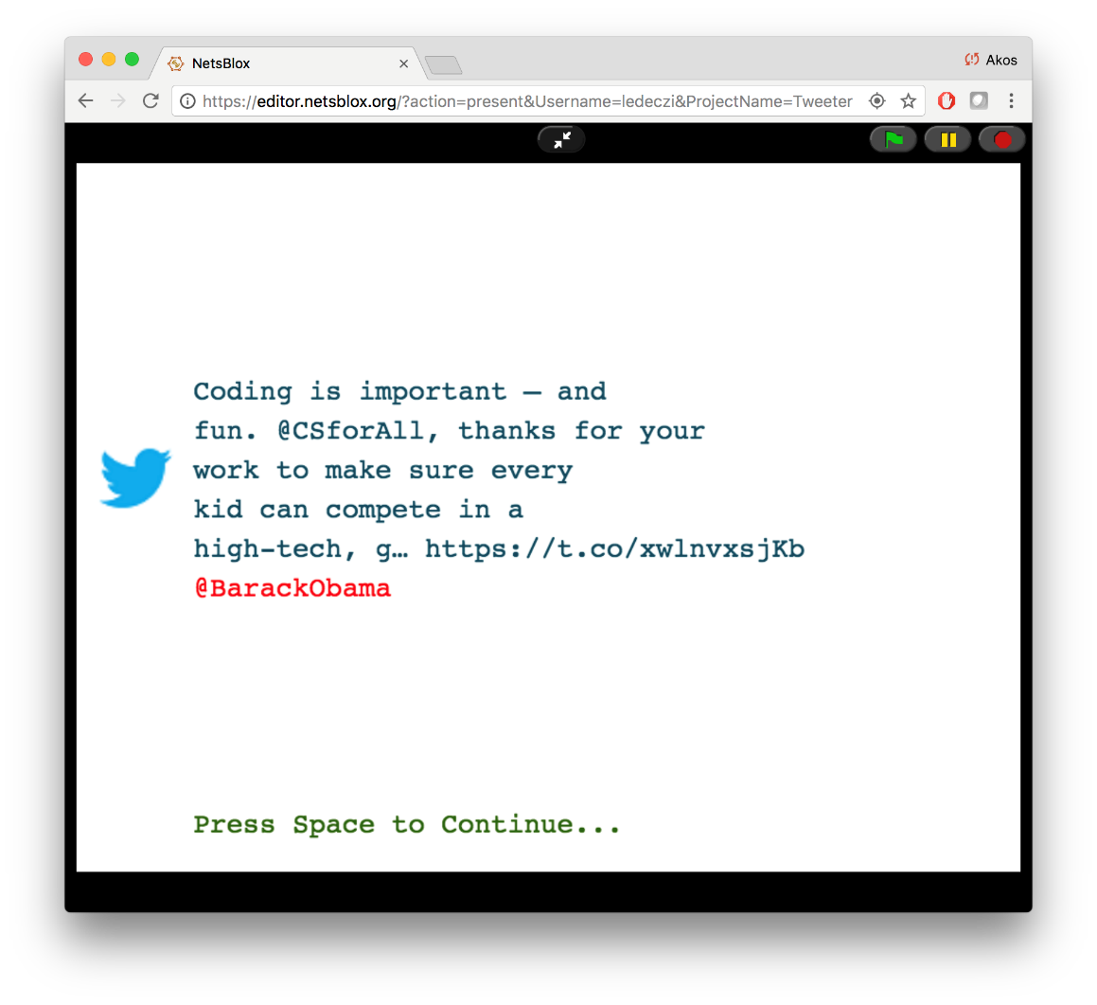
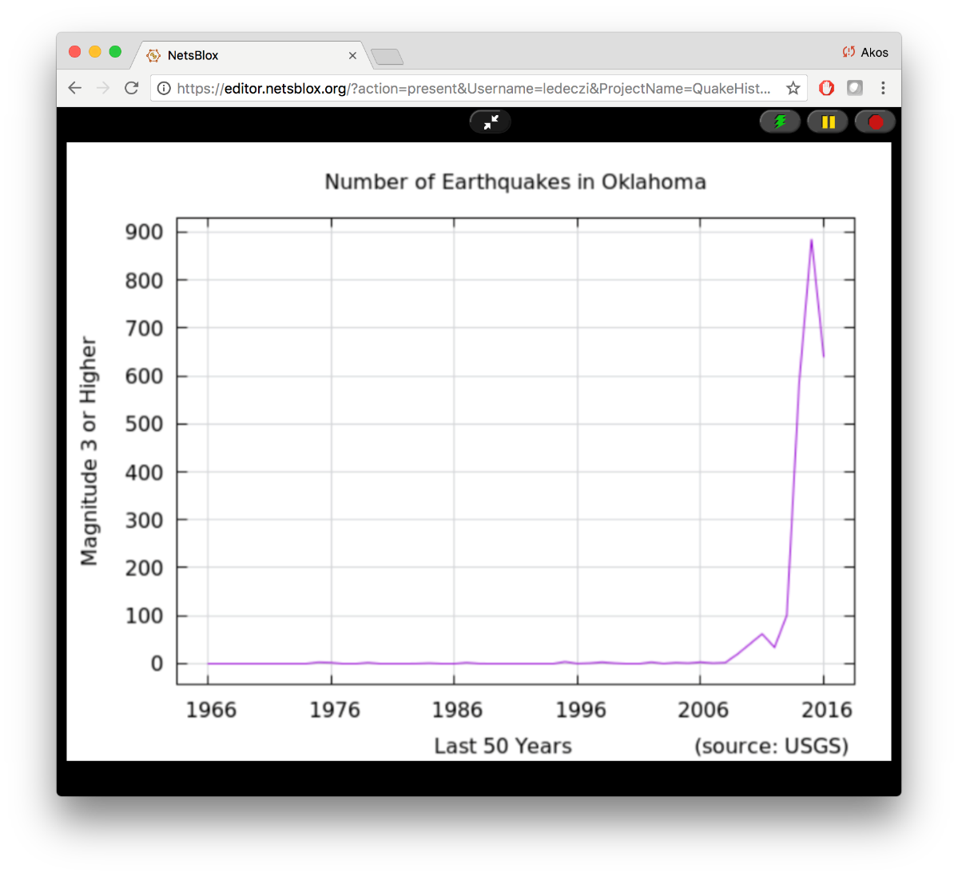
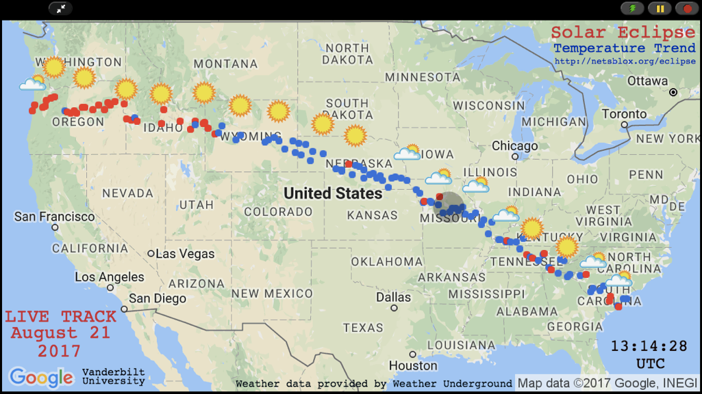
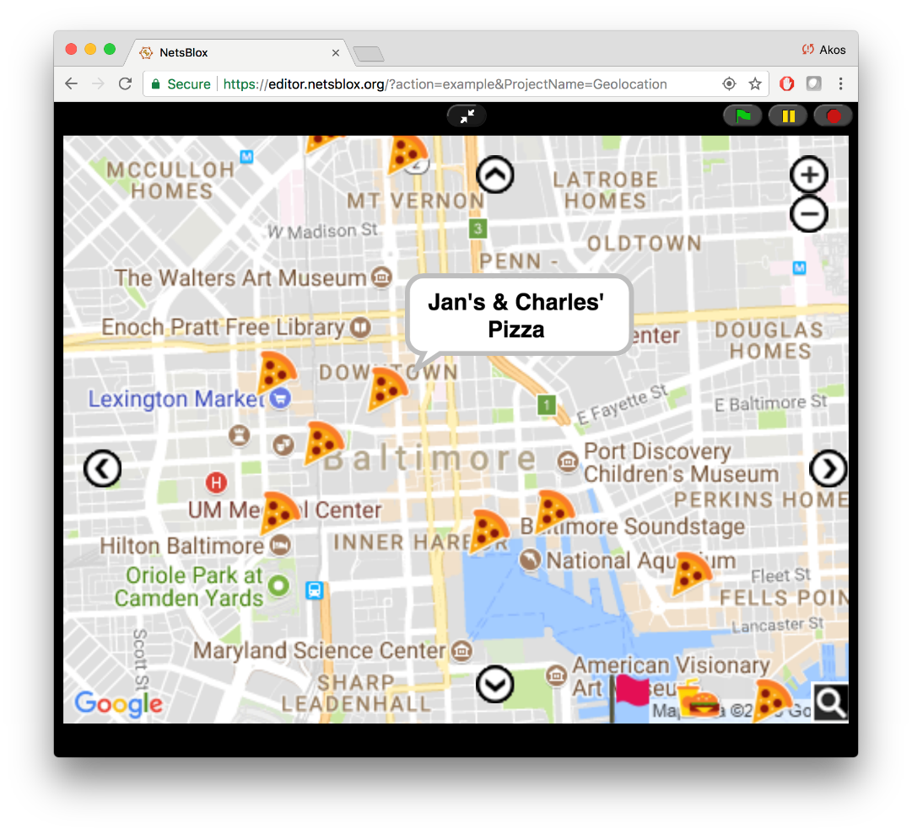
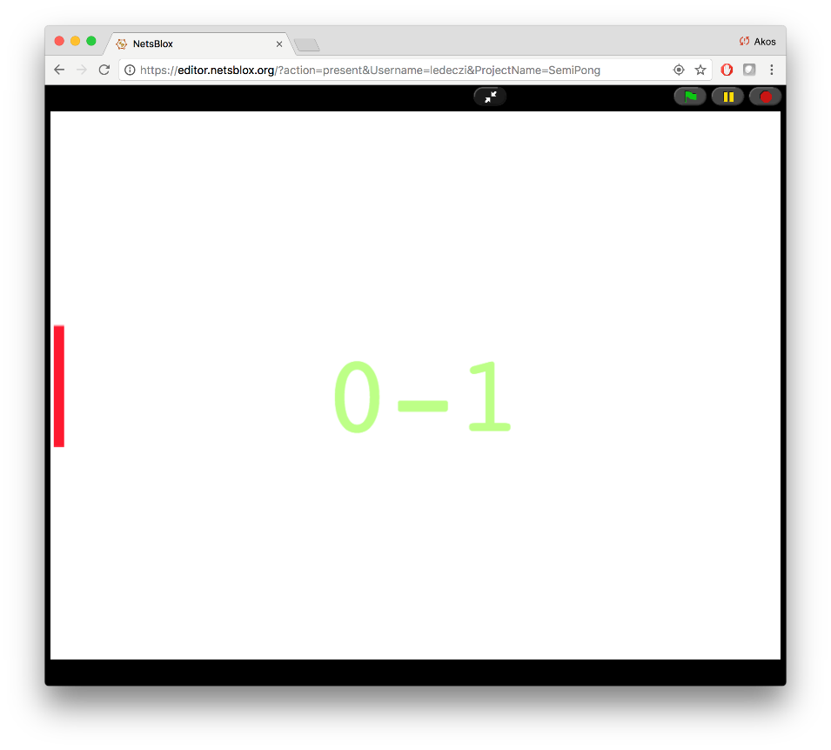
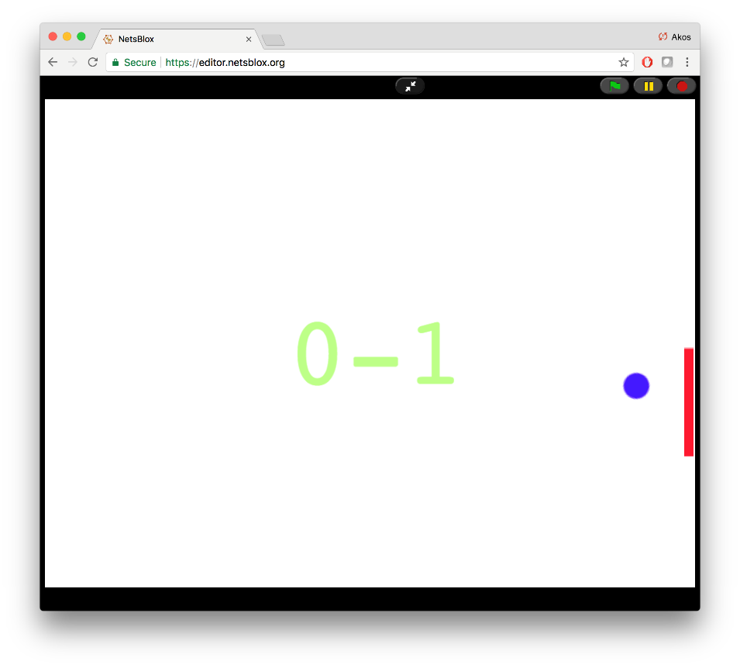
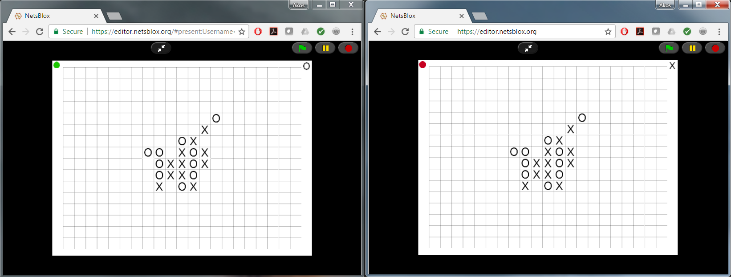
And many more distributed apps…

Slide 22
Robotics with a Difference
NetsBlox program runs in the browser
Uses RPCs to control the robots via WiFi
No wires, no need to download the program: just like programming a sprite
Robot sends messages back with sensor values
Programs can coordinate with messages: communicating robot teams
Robot commands are sent in the clear, can be overheard: Various cyber attacks and cyber defense techniques can be taught in a hands-on manner.
Robot driving competition where other students are allowed to cyber attack the current racer
Two summer camps last month: level of engagement was off the charts

Slide 23
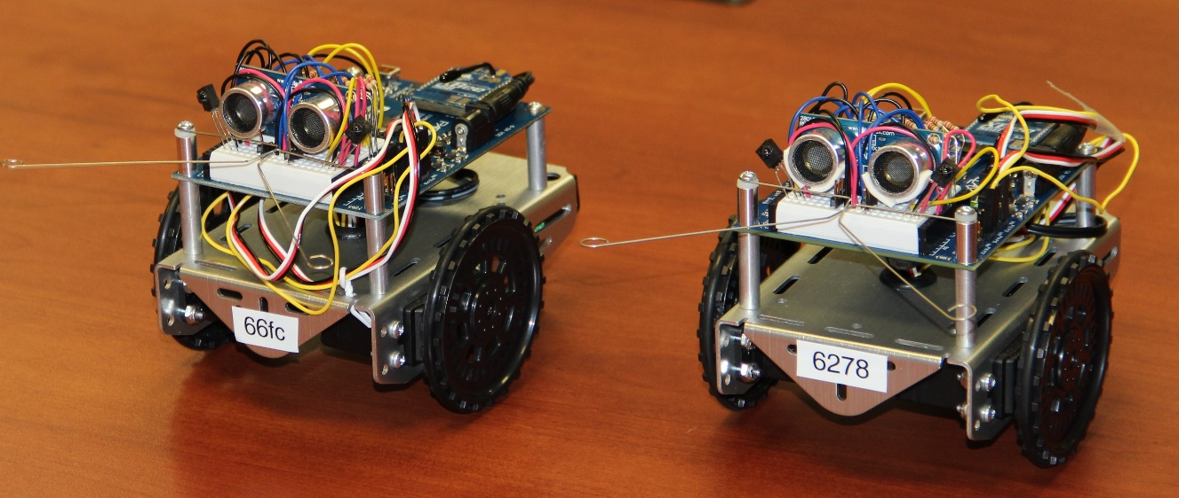
Robot Demo

Slide 24
Supported Services and Features
STEAM RPCs:
Google Maps (global)
Google Street View (global)
Geolocation Services (global)
USGS Earthquake Data (global)
Current Weather Conditions (global)
US Air Quality Information
Traffic Data
Sloan Digital Sky Survey
ThingSpeak IoT Database (global)
Water Watch
2017 Solar Eclipse Path and Temperature Data
Charting
Pixabay Image Database
Google Trends (global)
Twitter (global)
The Movie Database (global)
Stock quotes
British Museum Collection
Trivia
Key-Value Store
Game RPCs:
N Player Game
Connect N
Battleship
Hangman
Twenty Questions
RPCs to Access to Physical Devices:
Robot API
Robot API with Cybersecurity Emphasis
Features:
Online Collaborative Editing
Unlimited undo/redo
Replay entire history of project
Network message debugger

Slide 25
Beauty and Joy of Computing
Introductory computer science curriculum developed at the University of California, Berkeley, intended for non-CS majors at the high school junior through undergraduate freshman level.
Uses Snap!
One of the AP CSP courses being taught around the country
CS 10 at Berkeley
CS 1000 at Vanderbilt: brand new course based on BJC but adds hands-on distributed computing and computer networking units based on NetsBlox

Slide 26
Summary
NetsBlox opens the internet for students’ programs
Public data sources related to STEAM
Distributed programming/communication
Collaboration
More engaging increasing motivation
Allows for synergistic teaching of STEM and CT
High ceiling:
Can be used to teaching distributed programming from the basic concepts to advanced topics
In-progress:
Additional services
Server roles
User-defined RPCs

Slide 27
Questions?
Sponsors: National Science Foundation and
Vanderbilt University
https://netsblox.org
https://netsblox.org/CSTA18
https://www.facebook.com/netsblox/

